Slide 1
Lecture 19
Normal Probabilities, the Central Limit Theorem and Confidence Intervals

Slide 2
Review
1 What is a sampling distribution?
The distribution of a statistic, such as x̄, over all possible samples of size n.
2 What is the standard error of x̄?
σ / √n: how much x̄ varies from sample to sample.
3 For a continuous random variable, what is P(X = c)?
0: a single value has no width, so it has no area under the curve.
4 What is the standard normal distribution?
N(0, 1): the normal distribution of z-scores, with mean 0 and standard deviation 1.

Slide 3
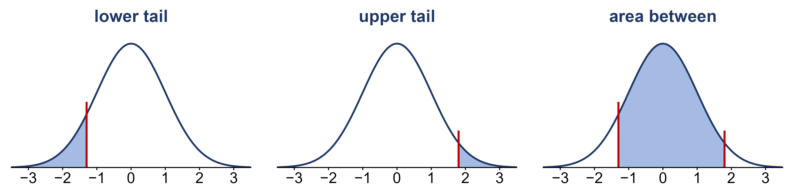
Three kinds of area
The z-table gives one kind of area only: the area to the left of z, P(Z ≤ z).
How would you get each shaded area from the z-table?
lower tail: P(Z < z) = table value upper tail: P(Z > z) = 1 − table value
area between: P(a < Z < b) = table value at b − table value at a

Slide 4
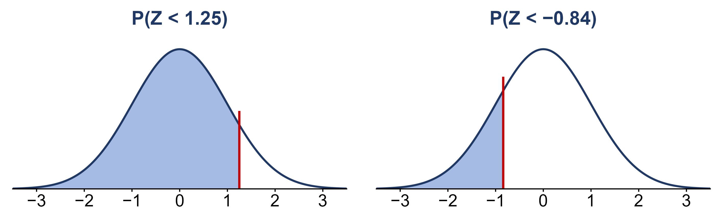
Example: lower tail
Z ~ N(0, 1), the standard normal. Find each shaded area with the z-table.
(a) P(Z < 1.25)? (b) P(Z < −0.84)?
(a) 0.8944 (b) 0.2005

Slide 5
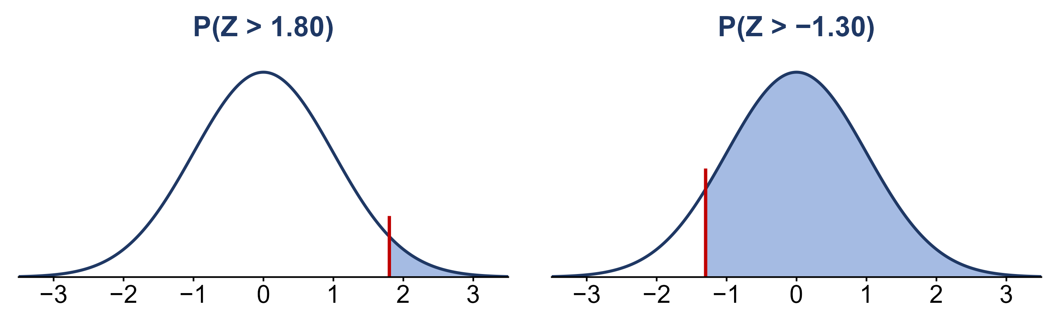
Example: upper tail
Z ~ N(0, 1). The table gives the area to the left, so subtract it from 1.
(a) P(Z > 1.80)? (b) P(Z > −1.30)?
(a) 1 − 0.9641 = 0.0359 (b) 1 − 0.0968 = 0.9032

Slide 6
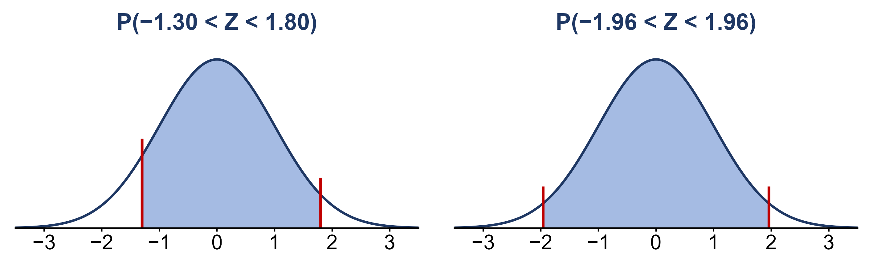
Example: area between
Z ~ N(0, 1). Take the area to the left of the larger value, minus the area to the left of the smaller.
(a) P(−1.30 < Z < 1.80)? (b) P(−1.96 < Z < 1.96)?
(a) 0.9641 − 0.0968 = 0.8673 (b) 0.9750 − 0.0250 = 0.9500

Slide 7
Practice: finding areas
Sketch the curve and shade the area first, then use the z-table.
Z ~ N(0, 1)
(a) P(Z ≤ 2.00)? (b) P(Z > 0.50)?
(c) P(−1 < Z < 1)? (d) P(−2 < Z < 2)?
Which rule from Week 6 do (c) and (d) match?
(a) 0.9772 (b) 1 − 0.6915 = 0.3085
(c) 0.8413 − 0.1587 = 0.6826 (d) 0.9772 − 0.0228 = 0.9544
The empirical rule: about 68% within 1 SD and 95% within 2 SD

Slide 8
Data: waiting for a goal
The 2022 World Cup had 172 goals in 64 matches: 2.69 goals per 90-minute match.
X = minutes until the next goal, simulated at 2.69 goals per 90 minutes
WAIT | MINUTES
1 | 1.6
2 | 54.3
3 | 57.3
4 | 27.2
5 | 18.3
… | …
μ = 90 / 2.69 ≈ 33.5 min; σ ≈ 33.5 min. Most waits are short and a few are very long.

Slide 9
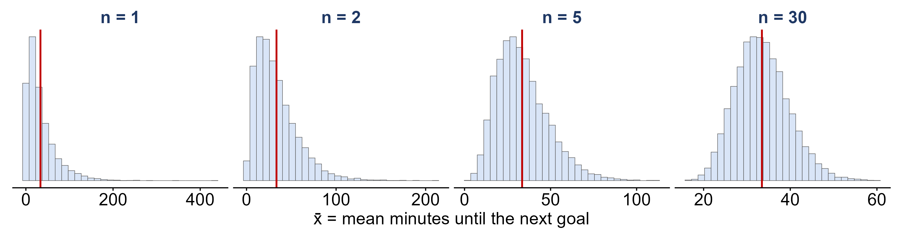
Averaging a skewed variable
Each panel: draw n waits, average them to get x̄, and repeat 10,000 times (n = 1 is a single wait).
As n grows, what happens to the shape, the center and the spread of x̄?
Shape: the skew fades into a bell. Center: stays at 33.5. Spread: shrinks like σ / √n

Slide 10
The central limit theorem
central limit theorem
for large n, x̄ is approximately N(μ, σ / √n), whatever the shape of the population
how large is large enough?
n ≥ 30 for x̄; np > 5 and n(1 − p) > 5 for p̂
why it matters
the empirical rule applies: about 95% of samples give a statistic within 2 SE of its mean

Slide 11
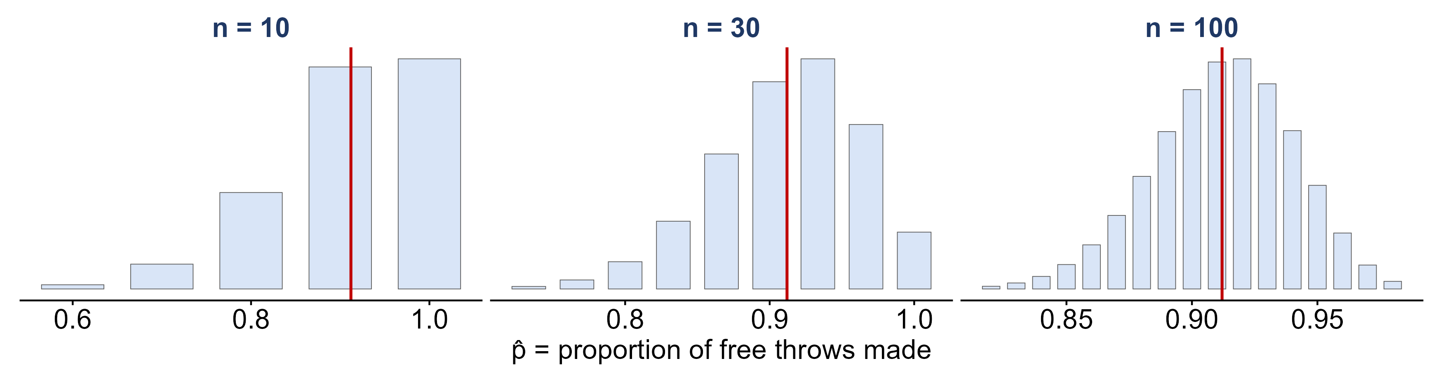
The CLT for a proportion
Exact sampling distributions of p̂, the proportion of free throws Stephen Curry makes; p = 0.912.
For which n is n(1 − p) > 5? Which distributions look like a bell?
n(1 − p) = 0.88, 2.64, 8.8: only n = 100 passes, and only n = 100 is close to a bell

Slide 12
Example: free throws, again
Over a stretch of n = 100 free throws, let p̂ be the proportion Curry makes.
p = 0.912; n = 100; n(1 − p) = 8.8 > 5
(a) What are the mean and standard error of p̂?
(b) About 95% of the time, p̂ falls between what two values?
(a) mean 0.912; SE = √(0.912 × 0.088 / 100) ≈ 0.028
(b) 0.912 ± 2(0.028): 0.856 to 0.968

Slide 13
Example: a tournament’s average
Goals per World Cup match: X ~ Poisson(λ = 2.69). A tournament averages over 64 matches.
μ = λ = 2.69; σ = √2.69 ≈ 1.64; n = 64
(a) What is the standard error of a tournament’s average?
(b) About 95% of tournaments average between what two values?
(c) How likely is a tournament that averages 3 or more goals per match?
(a) 1.64 / √64 ≈ 0.205
(b) 2.69 ± 2(0.205): 2.28 to 3.10 goals per match
(c) z = (3 − 2.69) / 0.205 = 1.51: P(Z > 1.51) = 1 − 0.9345 = 0.0655

Slide 14
From an estimate to an interval
point estimate
a single statistic used to estimate a parameter: x̄ for μ, p̂ for p
confidence interval
a range of plausible values for the parameter: estimate ± margin of error
95% confidence
the method captures the parameter in about 95% of all possible samples

Slide 15
Data: Spotify songs
Spotify and YouTube statistics for the top 10 songs of each of 2,079 popular artists, collected in February 2023.
X = the length of a song, in minutes
TRACK | ARTIST | MINUTES
Feel Good Inc. | Gorillaz | 3.71
Rhinestone Eyes | Gorillaz | 3.34
New Gold (feat. Tame Impala and Bootie Brown) | Gorillaz | 3.59
On Melancholy Hill | Gorillaz | 3.90
Clint Eastwood | Gorillaz | 5.68
… | … | …
18,860 different songs (a song credited to several artists is counted once)

Slide 16
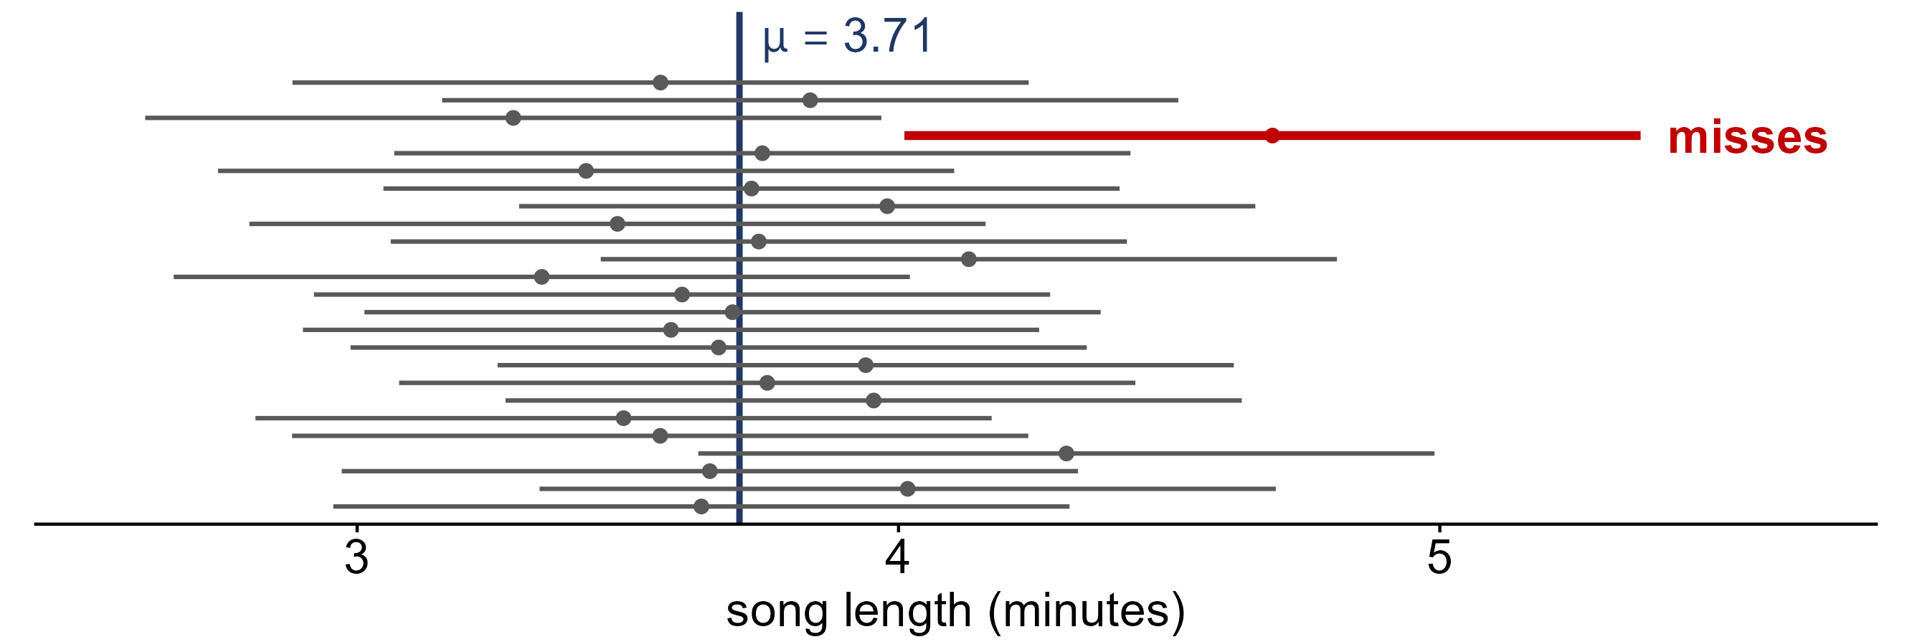
How often does an interval capture μ?
25 random samples of n = 20 songs; each line is x̄ ± 2(0.34), the margin of error.
How many of the 25 intervals capture μ = 3.71?
24 of 25: about 95% of intervals made this way capture μ

Slide 17
Example: an interval for mean song length
In practice we see only one sample: n = 20 songs (the bottom interval on the last slide).
x̄ = 3.64 min; σ = 1.51 min; SE = 0.34 min
(a) What is the 95% confidence interval for μ?
(b) Does it capture μ = 3.71?
(c) If we did not know μ, what would “95% confident” mean?
(a) 3.64 ± 2(0.34): 2.96 to 4.32 min (b) Yes
(c) 95% of intervals built this way capture μ; this one either does or does not

Slide 18
Confidence intervals for μ and for p
for a mean μ
x̄ ± 2σ / √n
for a proportion p
p̂ ± 2√(p̂(1 − p̂) / n): p is unknown, so the standard error uses p̂
when it works
the CLT applies: n ≥ 30 for x̄; np̂ > 5 and n(1 − p̂) > 5 for p̂

Slide 19
Data: teens and cell phones
A Pew Research Center survey asked 743 U.S. teens aged 13–17: “Are you losing focus in class by checking your cell phone?”
X = 1 if a teen answers “sometimes” or “often”, and 0 otherwise
RESPONSE | TEENS
Never | 289
Rarely | 216
Sometimes | 178
Often | 60
Total | 743
n = 743 teens

Slide 20
Example: losing focus in class
Estimate p, the proportion of all U.S. teens who lose focus in class “sometimes” or “often”.
178 + 60 = 238 of n = 743 teens
(a) What is p̂? Are there more than 5 successes and 5 failures?
(b) What is the standard error of p̂?
(c) What is the 95% confidence interval for p?
(a) p̂ = 238 / 743 ≈ 0.320; 238 and 505 are both > 5
(b) √(0.320 × 0.680 / 743) ≈ 0.017
(c) 0.320 ± 2(0.017): 0.286 to 0.354

Slide 21
What you should know
areas under the normal curve
lower tail = table value; upper tail = 1 − table value; between = difference
central limit theorem
for large n, x̄ and p̂ are approximately normal, whatever the population
confidence interval for μ
x̄ ± 2σ / √n
confidence interval for p
p̂ ± 2√(p̂(1 − p̂) / n): about 95% of intervals made this way capture p

